Slide 1
How PC Works
PC Works Based on
Memory handling
The registry
Windows boot
Windows architecture
systems and subsystem details
PE files
exe and dll

Slide 2
Memory handling
Boundary between the OS and user applications relies heavily on hardware-based mechanisms
Intel 32 based processors (and variants) implements memory protection through both segmentation and paging

Slide 3
The registry
Basically a database for info and config for everything.
regedit.exe
The 5 hives:
HKEY_CLASSES_ROOT
HKEY_CURRENT_USER
HKEY_LOCAL_MACHINE
HKEY_USERS
HKEY_CURRENT_CONFIG

Slide 4
HKEY_CLASSES_ROOT
Contains file type associations
HKEY_CURRENT_USER
Contains preferences and settings of the currently logged on user
Sup
porting files: Ntuser.dat, Ntuser.dat.log
.dat, a common file format (typically, generic file extension for data files by various applications with no universal format)

Slide 5
HKEY_LOCAL_MACHINE
PnP and HAL info is gathered here about the system's hardware
contains software, hardware, and security info
Also pulls info from the 4 other hives:
System
Software
Security
SAM
is one of the most major hive structures

Slide 6
HKEY_LOCAL_MACHINE (HKLM)
supporting files:
HKLM \SAM: Sam, Sam.log, Sam.sav
HKLM \Security: Security, Security.log, Security.sav
HKLM \Software: Software, Software.log, Software.sav
HKLM \System: System, System.alt, System.log, System.sav
all are stored in %System Root%\System32\config
stores all registry files
usually is C:\Windows\System32\config

Slide 7
HKEY_USERS
Contains data from every user in the SAM
contains info for that user's:
desktop
environment
program settings
network connections
printers
HKEY_CURRENT_CONFIG
contains PnP data about system's hardware devices that are used in the loading/startup process
Each time a user logs on, a new hive ("user profile hive") is dynamically built for that user
located under HKEY_USERS
Is dynamically created each time the system is booted

Slide 8
booting (also known as booting up) is the initial set of operations that a computer system performs after electrical power to the CPU is switched on or when the computer is reset.
the boot process begins with the execution of an initial program stored in boot ROM
Booting often involves processes such as performing self-tests,
loading configuration settings,
loading a BIOS, resident monitors, a hypervisor, an operating system, or utility software
A boot loader is a computer program that loads the main operating system or runtime environment for the computer after completion of the self-tests.

Slide 9
Second-stage boot loaders, such as GNU GRUB, BOOTMGR, Syslinux, or NTLDR
for dual or multi-booting from different partitions or drives
personal computers boot in about 1 minute, of which about 15 seconds are taken by a power-on self-test (POST) and a preliminary boot loader, and the rest by loading the operating system and other software
BIOS supports booting from various devices, typically a local hard disk drive via the Master Boot Record (MBR
PE format is used for EXE, DLL, SYS (device driver), and other file types
Software
Compiler
Installer
Process

Slide 10
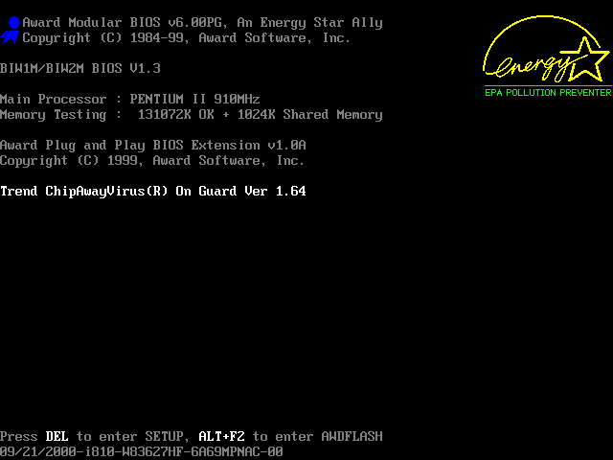

Slide 11
The principal duties of the main BIOS during POST are as follows:
verify CPU registers
verify the integrity of the BIOS code itself
verify some basic components like DMA, timer, interrupt controller
find, size, and verify system main memory
initialize BIOS
pass control to other specialized BIOSes (if and when required)
identify, organize, and select which devices are available for booting
The functions above are served by the POST in all BIOS versions back to the very first. In later BIOS versions, POST will also:
discover, initialize, and catalog all system buses and devices
provide a user interface for system's configuration
construct whatever system environment is required by the target operating system
(In early BIOSes, POST did not organize or select boot devices, it simply identified floppy or hard disks, which the system would try to boot in that order, always.)

Slide 12
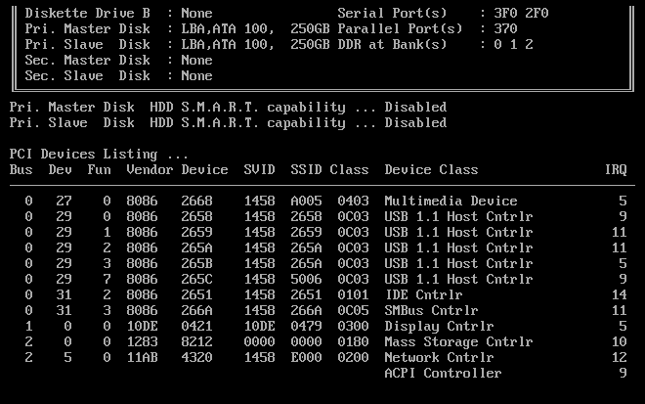

Slide 13
Original IBM POST beep codes
Beeps | Meaning
1 short beep | Normal POST – system is OK
2 short beeps | POST error – error code shown on screen
No beep | Power supply, system board problem, disconnected CPU, or disconnected speaker
Continuous beep | Power supply, system board, or may be RAM problem, keyboard problem
Repeating short beeps | Power supply or system board problem or keyboard
1 long, 1 short beep | System board problem
1 long, 2 short beeps | Display adapter problem (MDA, CGA)
1 long, 3 short beeps | Enhanced Graphics Adapter (EGA)
3 long beeps | 3270 keyboard card

Slide 14
POST AMI BIOS beep codes
Beeps | Meaning
1 | Memory refresh timer error
2 | Parity error in base memory (first 64 KiB block)
3 | Base memory read/write test error
4 | Motherboard timer not operational (check all PSU to MB connectors seated)
5 | Processor failure
6 | 8042 Gate A20 test error (cannot switch to protected mode)
7 | General exception error (processor exception interrupt error)
8 | Display memory error (system video adapter)
9 | AMI BIOS ROM checksum fix
10 | CMOS shutdown register read/write fix
11 | Cache memory test failed
12 | Motherboard does not detect a RAM module (continuous beeping)

Slide 15
Important beeps
Beeps | Meaning
Steady, short beeps | Power supply may be bad
Long continuous beep tone | Memory failure
Steady, long beeps | Power supply bad
No beep | Power supply bad, system not plugged in, or power not turned on
No beep | If everything seems to be functioning correctly there may be a problem with the 'beeper' itself. The system will normally beep one short beep.
One long, two short beeps | Video card failure

Slide 16
The Windows Boot
Post
CMOS
MBR - points to bootmgr - the windows boot manager
Bootmgr - loads and reads the Boot Configuration Data (BCD) file/store
BCD Store - reads which OSes are specified in the BCD store, and displays a menu to select which one

Slide 17
The Windows Boot
bootmgr resumes - loads Winload.exe, the windows boot loader
Winload.exe -
loads the kernel (ntoskrnl.exe), and loads HAL.dll into memory.
Then loads the SYSTEM registry hive
These processes are used to create registry key HKEY_LOCAL_MACHINE\SYSTEM
Winload uses the HKLM\SYSTEM key to load device drivers into memory (without starting them)

Slide 18
The Windows Boot
Winload checks if user wants to start using Last Known Good Configuration (pressing F8 key)
Winload starts:
memory paging (pagefile.sys) and
startup control passes to the ntoskrnl.exe (the windows kernel)
ntoskrnl.exe - causes the HAL to become active
builds HKEY_LOCAL_MACHINE\HARDWARE from info collected thusfar
ntoskrnl.exe starts critical services and drivers
located in C:\Windows\System32\Drivers

Slide 19
The Windows Boot
ntoskrnl.exe starts smss.exe (Session Manager SubSystem)
responsible for handing sessions running on a machine
starts the kernel and user modes of the Win32 subsystem
win32k.sys (kernel mode)
winsrv.dll and csrss.exe (both user mode)
starts any subsystems listed with the "Required" value in the following registry key:
HKLM\System\CurrentControlSet\Control\Session Manager\Subsystems
creates environment variables, virtual memory paging files
smss.exe = historically common target for malware
first native application in boot/startup

Slide 20
The Windows Boot
smss.exe starts the Win32 graphics subsystem
smss.exe starts csrss.exe (Client Server Runtime SubSystem)
provides the user mode side of the Win32 subsystem
console handling and GUI shutdown
the second native application
smss.exe starts Winlogon.exe (the logon manager)
Winlogon.exe starts services.exe (Service Control Manager)

Slide 21
The Windows Boot
Winlogon.exe starts lsass.exe (Local Security Authority Process)
displays the logon screen, prompting for user id and password.
handles authentication
Winlogon.exe executes userinit.exe
Userinit.exe
applies Group Policy settings and startup and policy settings
in the local user registry
not overridden by the Active Directory Group Policy

Slide 22
The Windows Boot
Winlogon launches Explorer.exe, the windows graphical Window Manager and shell
Whew thats a lot
that happens!

Slide 23
Subsystem Startup
Subsystems are started by the Session Manager (Smss.exe) process
Smss information is stored at:
HKLM\SYSTEM\CurrentControlSet\Control\Session Manager\Subsystems
starts any subsystems listed with the "Required" value in the following registry key

Slide 24
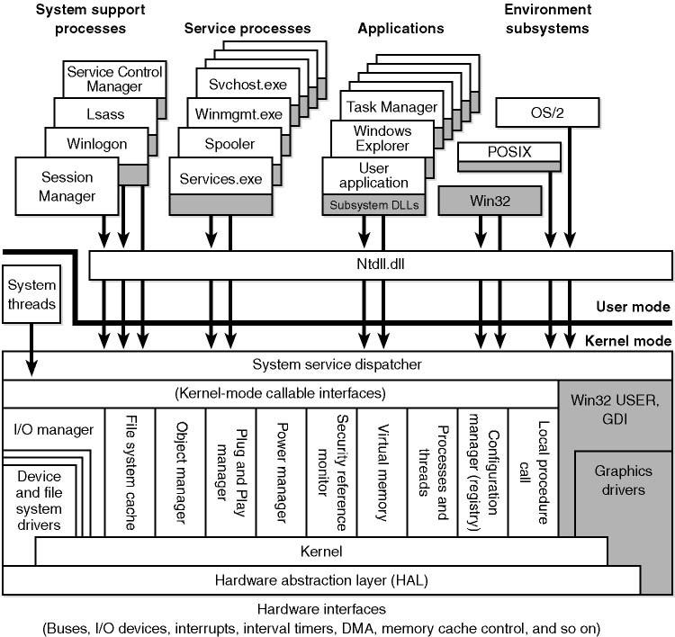
WINDOWS XP / WINDOWS 2000

Slide 25
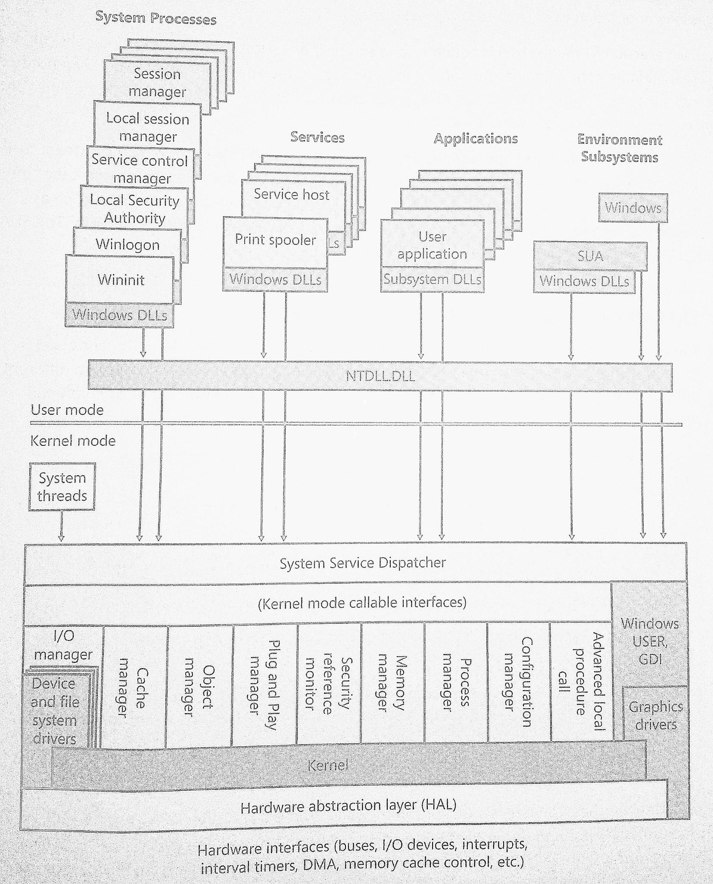
SUA = Subsystem for Unix-based
Applications
WINDOWS 7 / WINDOWS VISTA
Source: Windows Internals 6th edition, Part 1

